Slide 1
Section 2
Expressions of Concentration

Slide 2
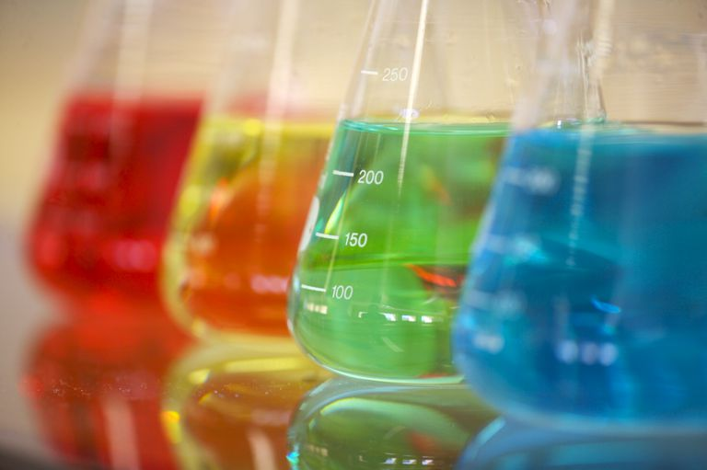
Review
Concentration is how much solute is present a certain amount of solvent or solution

Slide 3
Molarity
Ratio of the moles of solute to LITERS of solution
Reminder: There are 1,000 mL in a L
moles of solute
Molarity (M) =
Liters of solution

Slide 4
When Given Grams
Convert grams to moles using molar mass from PERIODIC TABLE
Then use the formula to solve for molarity

Slide 5
Example
A 4.00 g sugar cube (sucrose: C₁₂H₂₂O₁₁) is dissolved in a 350 ml teacup filled with hot water. What is the molarity of the solution?
Step 1: Convert grams to mols
= 0.0117 mol
Step 2: Convert mL to L
= 0.35 L
1 mol
4.00 g C₁₂H₂₂O₁₁ =
342 g
1 L
350 mL =
1,000 mL

Slide 6
Step 3: Use the formula to solve for M
= 0.033 M
moles of solute
Molarity (M) =
Liters of solution
0.0117 mol
M =
0.35 L

Slide 7
Practice
Worksheet

